Slide 1
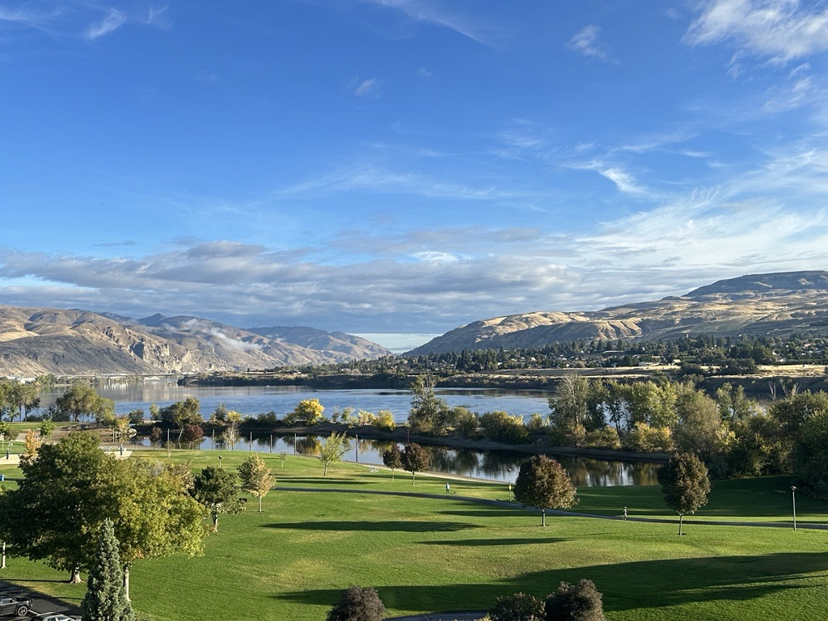
Health
Where Equity, Innovation and Engagement meet

Slide 2
Enduring Commitment to Honoring Our
Government to Government Relationship with Tribes
Looking Back
Commemorate One Year Anniversary of Native and Strong Lifeline ~ 1st in nation.
Creation of new internal Office of Tribal Public Health and Relations (OTPHR).
Engagement on key areas such as behavioral health/opioids, emergency preparedness, data sovereignty, environmental health, and foundational public health services funding.
Looking Ahead
Continue focus on above areas, especially data sovereignty and fentanyl & opioid crisis.
Implementation of public facing education campaign on health & wellness, with key focus on holistic health (physical, nutritional, behavioral, and spiritual health).
Investment of resources to improve communication and coordination of our agency ~ through OTPHR ~ with tribal leaders and their teams.
@WaDeptHealth
@WaHealthSec
@Ushahmd
1

